Slide 1
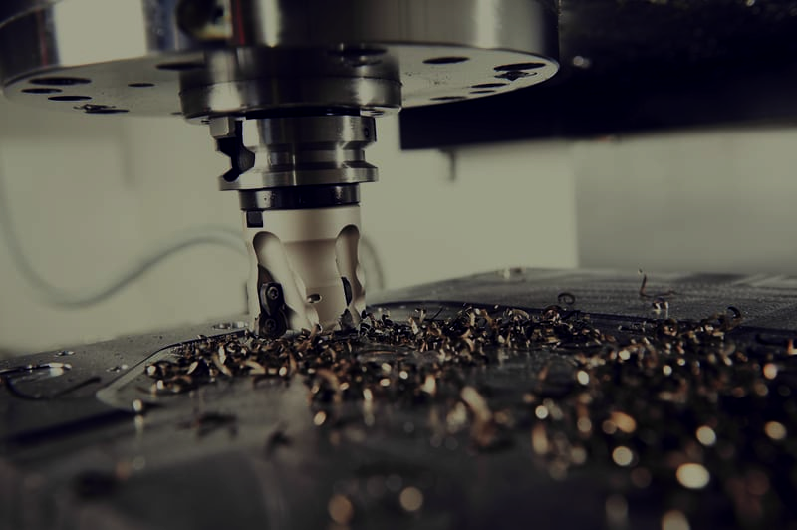
Modelling of chatter vibration
in thin-wall milling and its effect on surface roughness of job
P2 G5
Deep Patel 2018A4PS0526P Rudhir Mehra 2018A4PS0523P Saptarshi Das 2018A4PS0535P Utkarsh Anand 2018A4PS0539P R Harikrishna 2018A4PS0560P Himanshu Sharma 2018A4PS0556P
Submitted to:
Prof. TC Bera

Slide 2
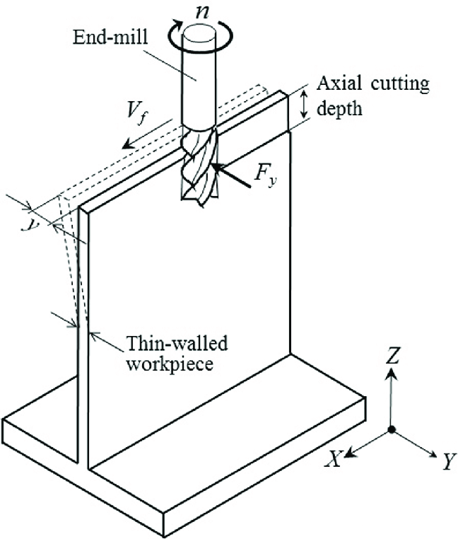
Thin-walled Milling and Chatter Vibration
What is thin-wall milling? While milling, when the thickness of the workpiece, from which material is removed, is too thin then we called is as a thin-walled milling.
What is chatter vibration? Chatter is an induced phenomena and maintained by forces generated by the cutting process. Chatter resistance of a machine tool is usually characterized by a maximum stable depth of cut.This chatter can occur both in the tool as well as in the workpiece also. Chatter in high speed milling is characterized by time delay differential equations (DDE).
What is normal vibration? Vibration is caused by external sources like movement of machine parts due to high speed rotation, high rigidity of tool and work piece, etc.

Slide 3
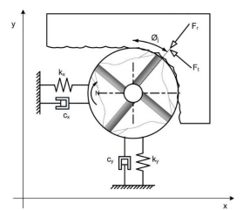
Analogy with spring mass model
We consider the vibration characteristics of the tool to be analogous to a two-degree of freedom spring mass system.
The two-degree of freedom system has two natural frequencies and given an excitation, the
system will vibrate at one of these frequencies.
During free vibration, the amplitudes of these two degrees of freedom are related and their
configuration is called the normal mode of vibration.
This model considers self excited regenerative mechanism as the source of chatter.
The regenerative chatter is associated with the modulation of chip thickness
between subsequent tool passes and this results in oscillatory cutting forces which in turn
Leads to a periodic oscillatory motion of the workpiece-tool system which is characterised
By different modes of vibration.
The modes perpendicular to the cutting axis are considered dominant and thus used for
analysis.

Slide 4
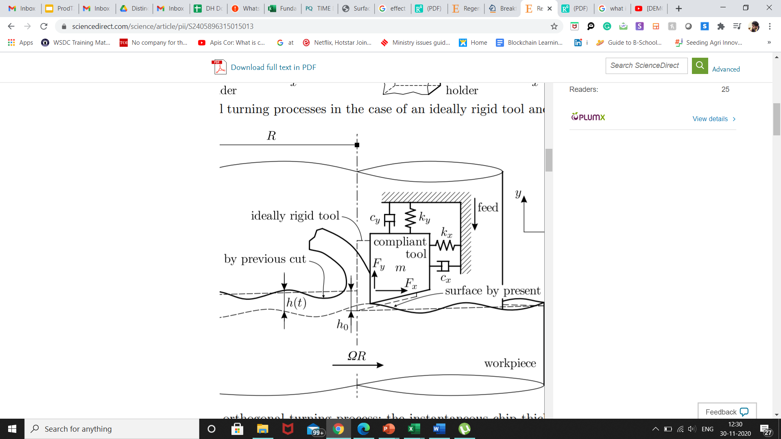
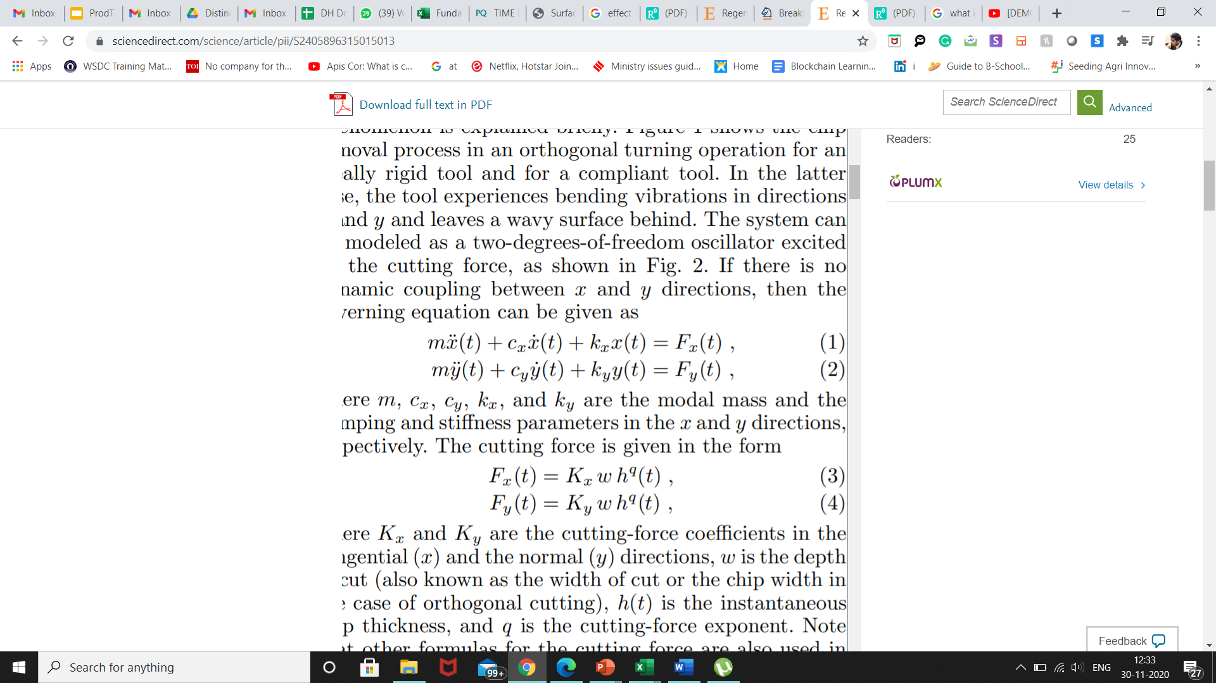
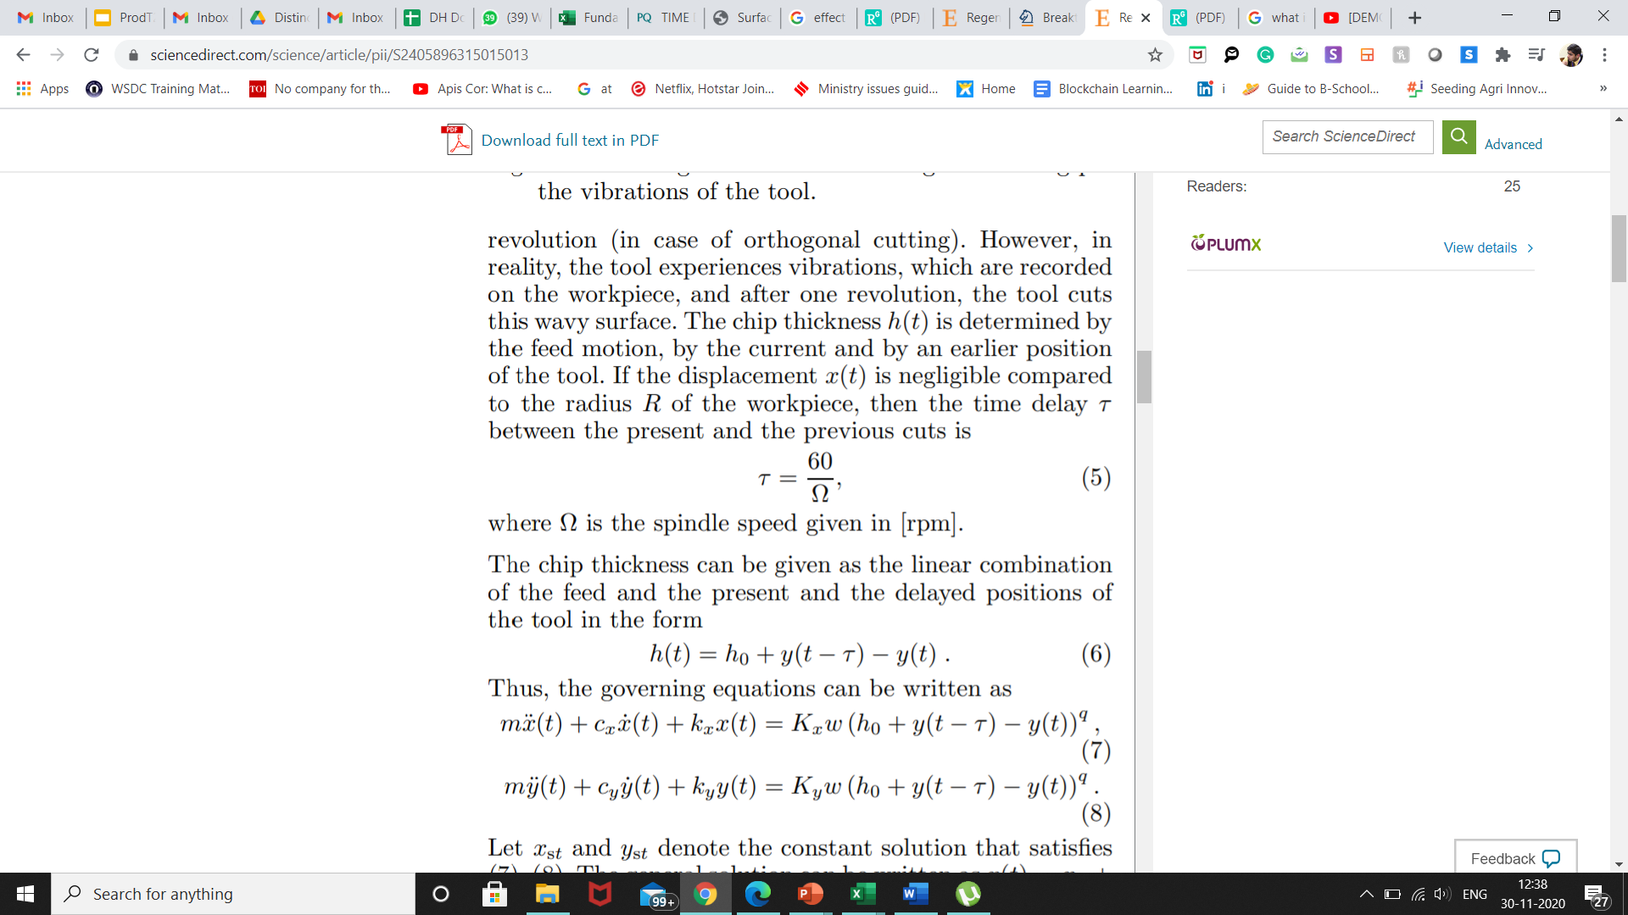
Modelling of Chatter Vibrations
Importance: The regenerative effect has been extensively studied in the field of metal cutting and recognized as one of the major causes of self-excited vibrations commonly known as chatter.
Cause: This effect arises from a periodic modulation of the uncut chip thickness within the frequencies of the eigenmodes, which results in a critical excitation in the consecutive cuts or tooth engagements.
Regenerative Delay & Parametric Excitation: Due to regenerative delay intern lead by the surface waviness, there is a time delay factor that creeps in. This occurs in real life since our systems are not rigid.
Original Equations for damped oscillations in milling

Slide 5
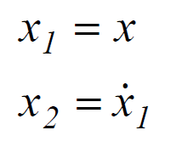
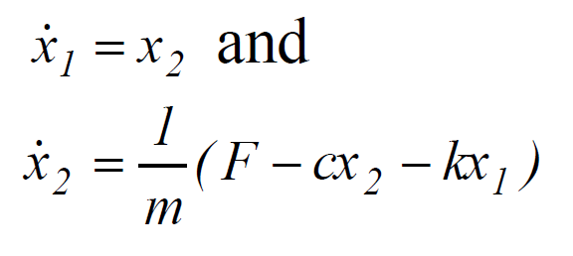
Chatter vibration simulation in MATLAB
In order to solve a higher order differential equation, we have to first express it as first order simultaneous differential equations.
The exact chronology of steps for calculations using dde23 solver is given in the flow chart.

Slide 6
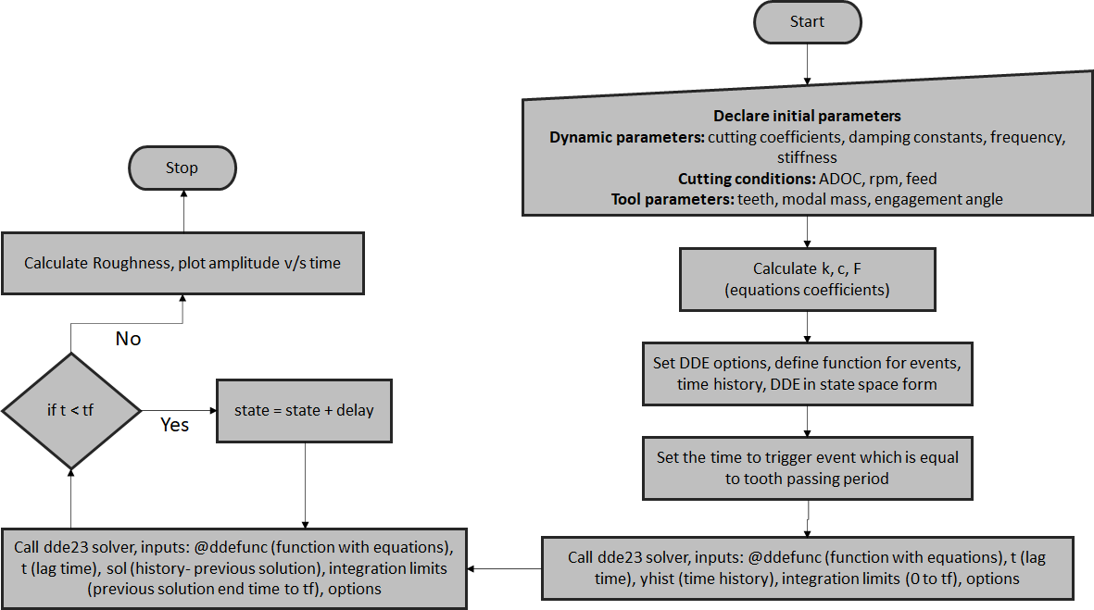
Algorithm and control flow

Slide 7
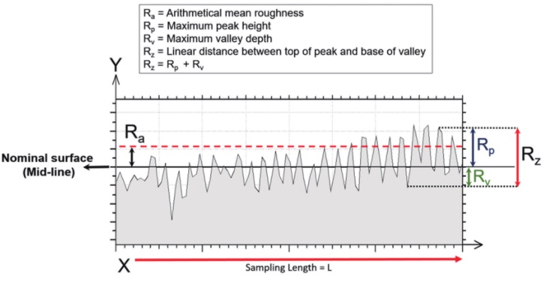

_{What is Surface Roughness?}
Surface roughness is a component of surface texture which is quantified by the deviations in the directions of the normal
vector from its ideal form. The surface can be said to rough or smooth depending on how large these deviations are.
Surface Roughness parameters
R_{a} - It is the arithmetical average value of all absolute distances
f the roughness profile from the centre line. It is known as
arithmetic mean roughness.
R_{t} - It is the total height of the profile ie. the vertical distance
between the highest peak and the deepest valley.
R_{q} - it is the root mean square variation of the profile deviations
along the sampling length.

Slide 8
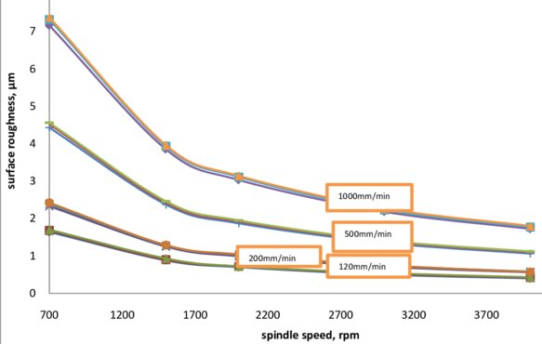
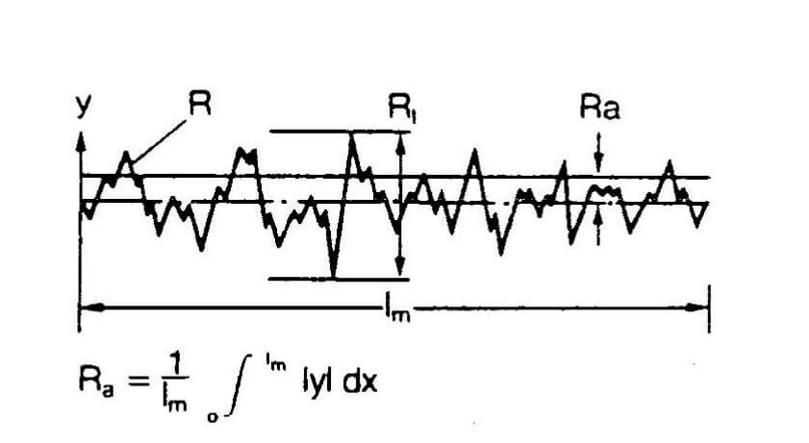
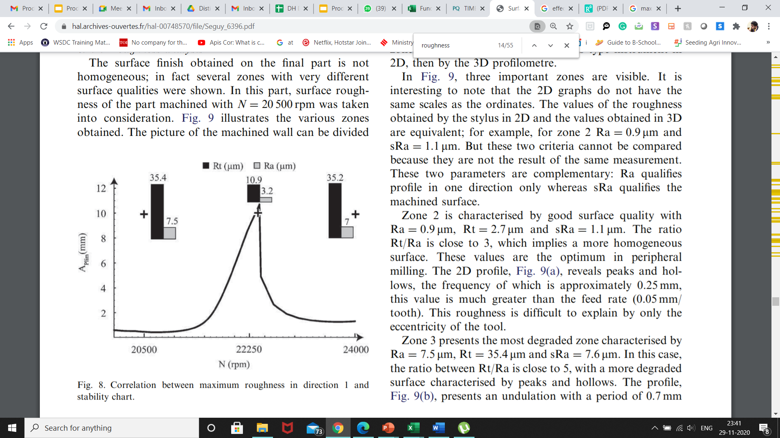
Effect of Chatter vibration on Surface Roughness
Without Chatter
To study this let’s first consider the variation of surface roughness in a milling process with spindle speed without any chatter vibration.
As we increase the spindle speed the surface roughness reduces.
Without Chatter Vibrn
Peak of
profile
Avg surface roughness
With Chatter
With chatter vibration the overall extremas of the surface vary more. This leads to more depths and craters. The effect is not uniform but can be mapped by using the Rt/Ra ratio vs the spindle speed.
Roughness is lowers for low Rt/Ra ratios since this means that the amount of deviation from mean is less. This was true for 22250 rpm whereas it was high for 20500 and 24000 rpm. So no fixed trend.

Slide 9
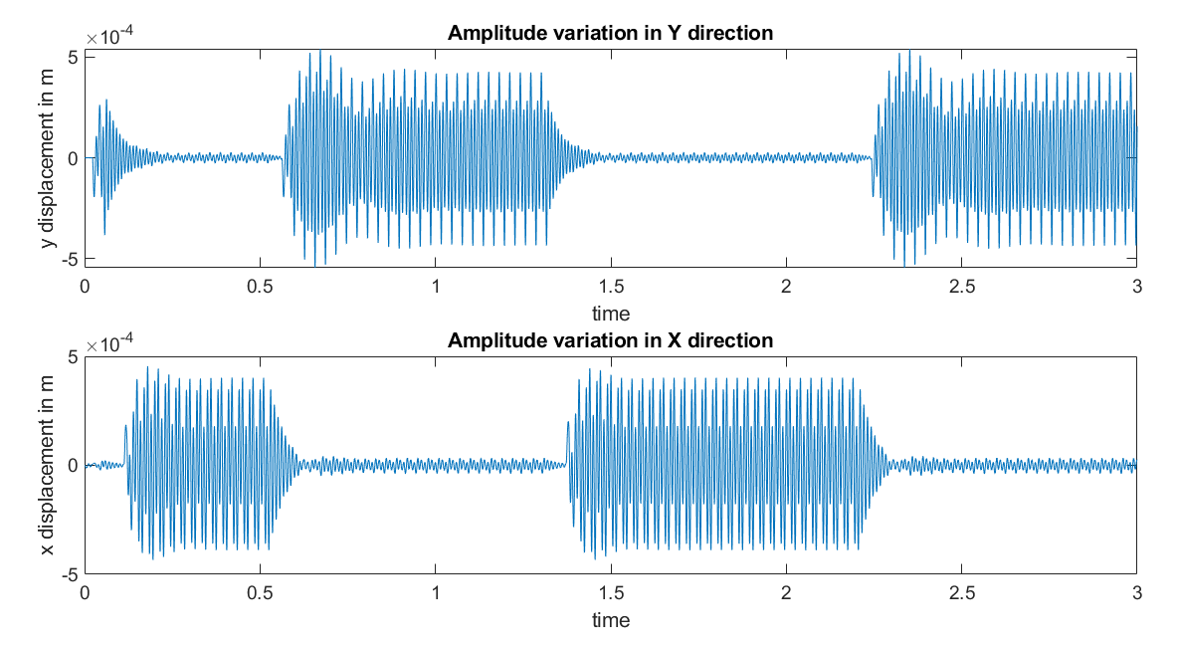
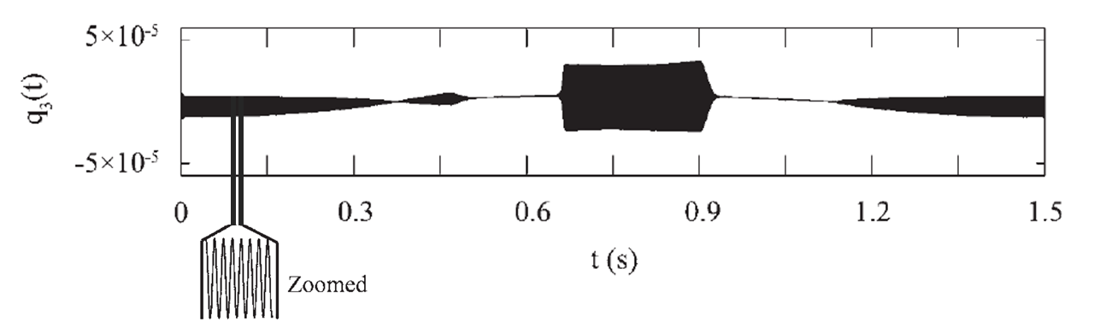
Conclusion and Results
Our results seem to agree with the results obtained in the literature. The vibration profile shown below is for 3mm ADOC and 2000 rpm. The sudden valleys and peaks occurring in the graph are due to superposition of two different modes of vibration. These modes of vibration are obtained in seguy et.al. by Ansys simulation.
The proposed method is suitable to solve problems with an initial profile. The procedures developed in this study are helpful for the study of non-linear chatter problems in high speed machining.

Slide 10
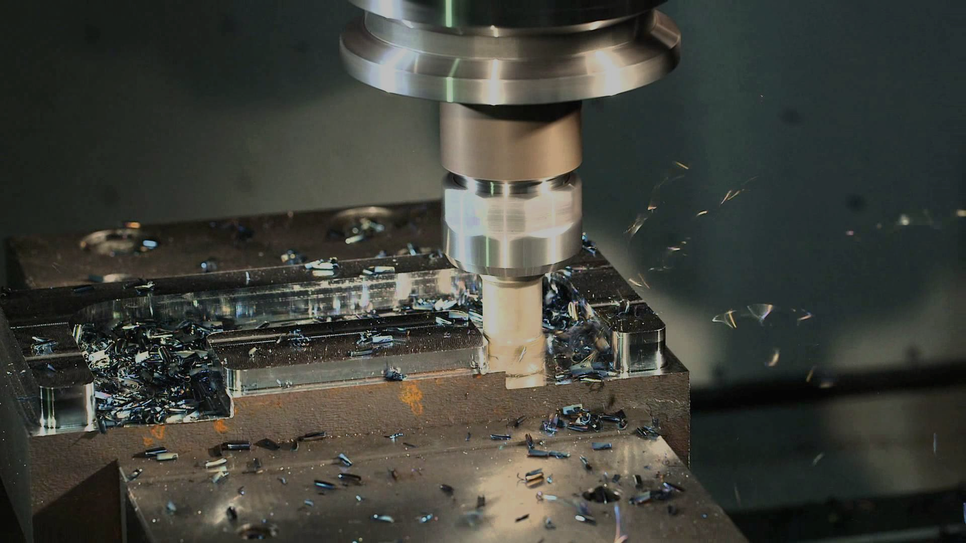
Thank You !!

